Slide 1
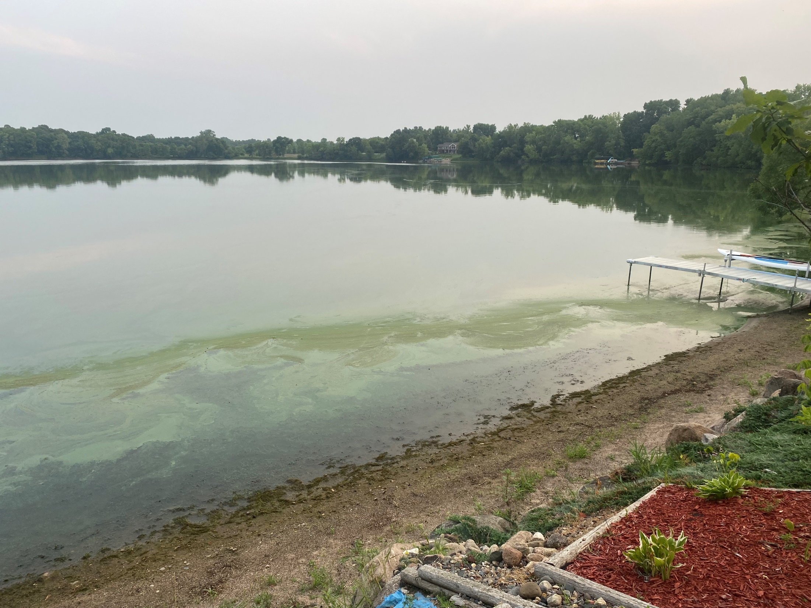
Algae Options/Discussion
Prepared for Lake Martha Residents

Slide 2
Why does this happen?
The algae blooms happen when the following ingredients are present
Lots of nutrients
Nitrogen /Phosphorus
High surface water temperatures
Sunlight
Lack of water movement
Dead Organic Matter

Slide 3
Common approaches to Algae Reductions
Reducing incoming Nutrients
Filter incoming water
Shoreline buffer zones
Less fertilizer use
Aeration
Chemical
Copper Treatments
Kills existing algae it contacts
Alum/Iron Treatments
Tie up existing nutrients and pin them to the bottom
Biological
Barley Treatments
Decaying barley hinders algae reproduction
Place it in bags around the lake
Introducing “good” bacteria to reduce dead organic matter
Ultrasound
Smaller bodies of water
Ultrasound “sinks” Algae depriving it of sunlight and hinders reproduction

Slide 4
What has already happened at Lake Martha?
Weed Cutting (1980’s) to remove future nutrients-dead weeds
Installation of DNR Culvert (1987) to control lake level
Iron Treatments (1990’s) to tie up phosphates on the bottom
Replacing individual sewers (2001) to reduce incoming nutrients
Periodic Copper Treatments to kill existing algae(Unknown but most years for likely decades)
Iron/Sand Filter (2014) on south side of lake to Pre-Treat Farm run-off-reduce incoming nutrients
Aeration (2019 and ongoing)
Lake Level Control maintenance (2020) to reduce tree/shoreline erosion
Whole lake weed Treatment (2021)

Slide 5
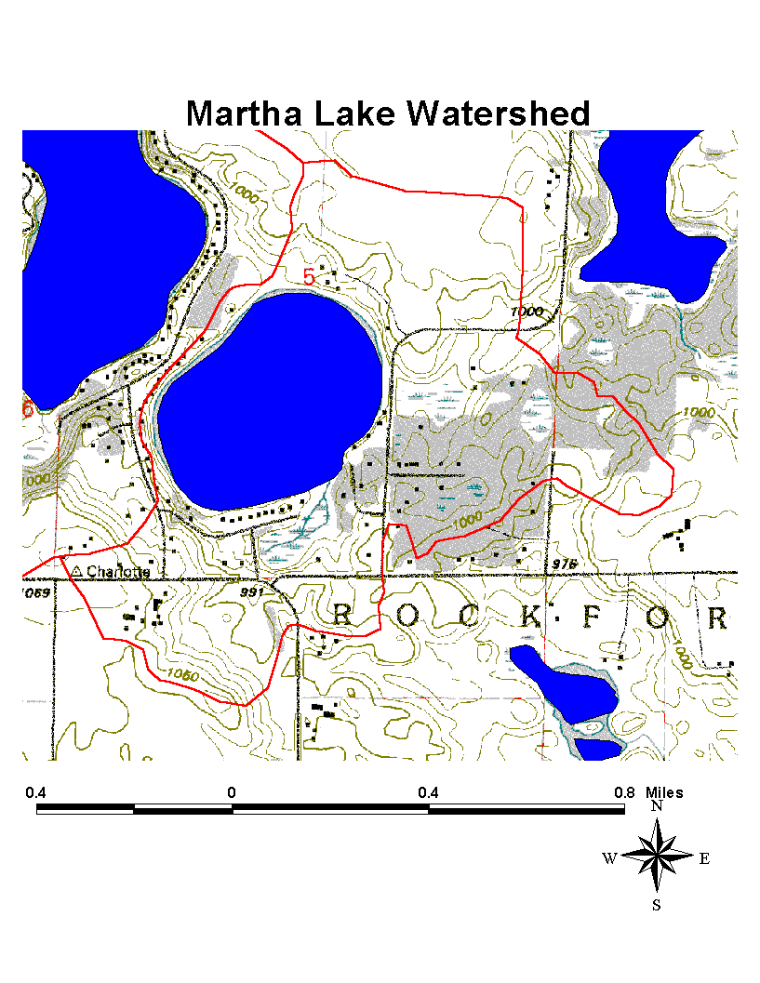
Nutrients
Where do our nutrients come from
Outside sources
Nearby Ag activities
Lawn Fertilizers
Internal Sources
Dead weeds/Fish

Slide 6
Nutrient Reduction
Incoming Stream on East side-is filtered by wetland
Incoming Stream in Bay is filtered by sand/iron trap and further by the shallow bay
Lake Level control reducing bank erosion
Killing Curly leaf sooner and reducing volume of dead weeds
What else can we do
-Be responsible with lawn fertilizers
-native grass buffer zones where possible to filter runoff

Slide 7
Aeration
Aeration on its own does not kill algae but it does give oxygen to beneficial bacteria to help them thrive. This bacteria breaks down dead organics which starves future algae blooms.
Is it working???
-may simply need more time to get our bacteria thriving and eat down that steadily increasing volume of curly leaf we’ve been putting in every year.
-possible the years of copper treatments have reduced our beneficial bacteria and the increased oxygen is having limited effect.
-Can relook at sizing to see if its something where more aerators would help

Slide 8
Copper Treatments
Copper Sulfate is probably the most commonly used algaecide in lakes/ponds because it works,
Very Toxic to Algae, effective in the short term
Expect 1-2 weeks effectiveness
Long term it may actually promote algae blooms
The copper buildup in sediments kills beneficial bacteria that helps break down organics
The dead algae becomes nutrients for future algae.

Slide 9
Alum/Iron Treatments
Alum (Aluminum Sulfate) and Iron treatments both work the same
tie up Phosphorus and drag it to the bottom so its not available to algae, does not directly kill algae
Alum seems to be the common option applied today a barge (liquid form)
Seen as a Environmentally Friendly option.
Its done in drinking water reservoirs
Expect immediate effectiveness lasting 5-10yrs,
Then maintenance is required,
Effective in shallow lakes that are not wind swept, Want bottom not to get stirred up to keep phosphorus locked up on the bottom.
Wind protection and Lack of carp in Martha would be beneficial
Lots of MN case studies out there with significant water clarity improvements

Slide 10
Alum Costs
$$$ -This is expensive
A quote would be needed but this could be in the neighborhood of $100K-$150K for a 100 acre lake
phosphorus studies and alum application.
Grants from the state do occur for this but not common, I think it would help if we can get Martha on the list of “impaired” lakes maintained by Minnesota Pollution Control Agency.
Many of the popular lakes in wright county are already on this list (Pulaski/Charlotte ect)

Slide 11
Barley treatments
Its unclear why this seems to work but filling up mesh bags with barley in the spring and letting them degrade seems to slow algae reproduction. The bag is removed in the fall.
Cheap and Environmentally friendly but not sure how practical this is for Martha, We are talking about 200-300 bales of barley for a 100 acre lake.

Slide 12
Ultrasound
Not commonly used but Ultrasound generators are placed around lake and turned on which sinks algae, Starving it of sunlight it needs to reproduce.
Not real practical in a lake with boat traffic

Slide 13
Has any of this actually worked in Lake Martha?

